Slide 1
Animation Workflows Between Blender And Unreal Engine 4
Ariana Alexander

Slide 2
About Me
3D artist and animator
Work at Timefire VR on a platform called Hypatia
Co-Founder of Phoenix chapter of Women in Games International (WIGI)
Shameless plug: WIGI has a new Meetup Page! https://www.meetup.com/WIGIPHX/

Slide 3
Why Use Blender?
It’s free (Open Source)
You can use it commercially
Great for Indies!
Works just as well as Maya or Max, and in some ways, faster

Slide 4
Why Use Blender?
You can learn about it online for free
Good alternative for students to pirating Maya after they graduate
It’s another tool for your toolbag
It’s awesome!!

Slide 5
Demo Time!!
Exporting Skeletal mesh and animations
Morph Target Animation
Same Skeleton Retargeting

Slide 6
In Case You Forget...

Slide 7
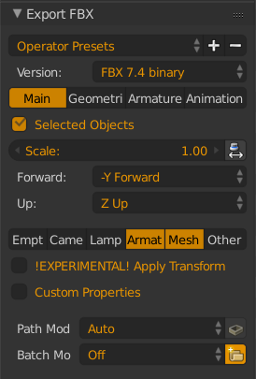
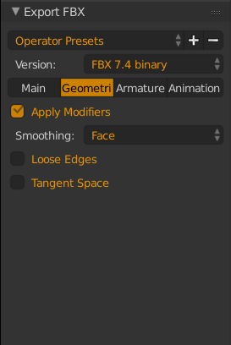
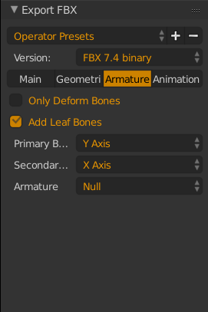
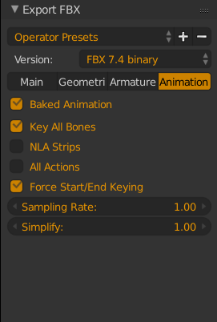
Skeletal Mesh Export Settings

Slide 8
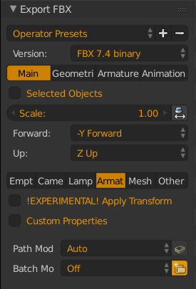
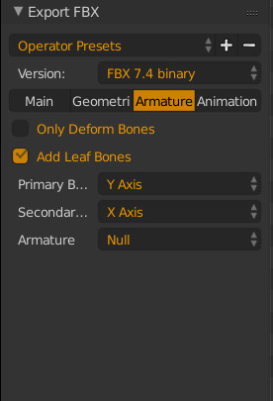
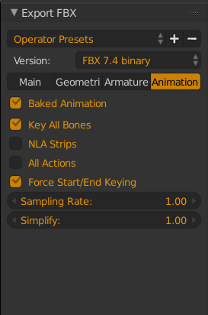
Animation Export Settings

Slide 9
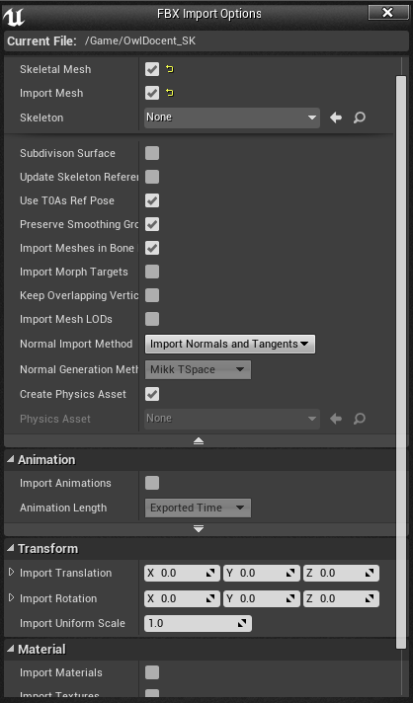
Importing to Unreal!
Skeletal Meshes

Slide 10
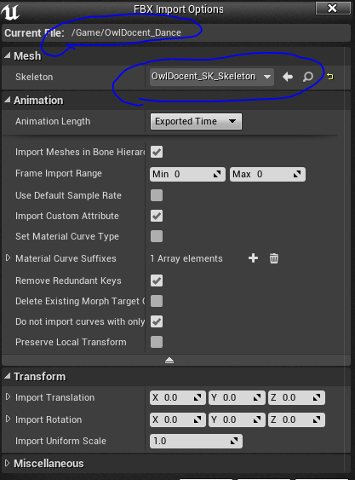
Importing to Unreal!
Animations

Slide 11
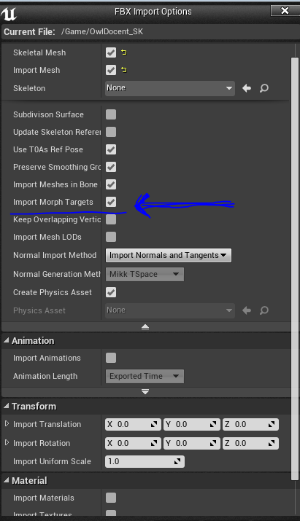
Importing to Unreal! (Morph Targets)
Animating in Unreal using anim curves
Animating from Blender using Bone drivers
Appropriate skeleton

Slide 12
Links
MakeHuman
Unreal PHX
Blender

